Slide 1
Protein Classification
by Profile Hidden Markov Models
and Anti Profile Hidden Markov Models
洪嘉君ª，呂仁園^{b,c}
醫學系ª，電機系所^{b}，資訊所^{c}
長庚大學
Email: rylyu@mail.cgu.edu.tw
alden@med.cgu.edu.tw
Tel: 886-3-3283016#5677

Slide 2
Introduction to Protein family classification
Understanding the structure and function of a protein is significant in medical diagnosis and drug design.
Identifying that a protein sequence belongs to a family, and aligning it to the other members, often inferences about its structure and function.
In this paper, we use protein sequences to predict their family classification.

Slide 3
Stochastic Modeling of Protein Sequences
The bio-sequence analysis is very similar to speech recognition, where Hidden Markov Model (HMM) plays a major role in the past decades.

Slide 4
The Process of Speech Recognition using HMM-based Algorithms
Vector sequence
Speech
waveform
v[n]
Feature Extraction
Vector Quantization
s[t]
Vector category
index sequence
x[n]
HMM-based Searching
w[m]
Linguistic unit sequence

Slide 5
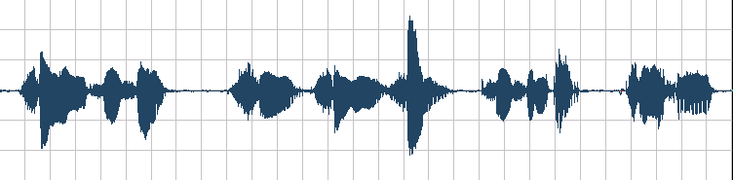
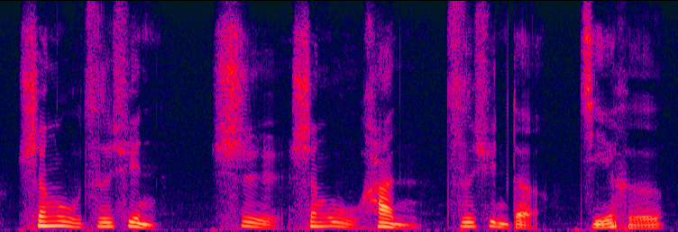
The Process of Speech Recognition using HMM-based Algorithms
Feature Extraction
Vector Quantization
x₁
x₂
x₃
x₄
x₅
x₆
…………………………………………..
x_{t}
x_{t+1}
………………………………………………………………………….
x_{T}
HMM-based
Alignment &
Search &
Classification
#
eng
z
x
#
ii
eng
u
h
an
#
z
x
d
e
#
j
ie
h
e
#
sh
u
ii
yun
sh
sh
ii
yun
sheng-u-zii-xyun
shii
sheng-u
han
zii-xyun
de
jie-he
生物資訊
是
生物
和
資訊
的
結合

Slide 6
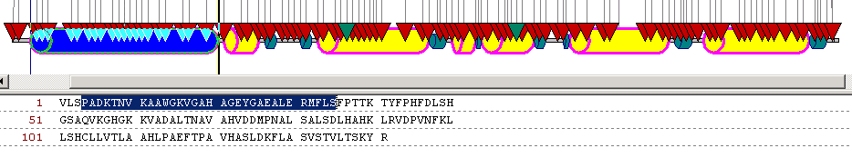
Typical Bio-sequence Analysis
vlspadktnvkaawgkvgahageygaealermflsfpttktyfphfdlshgsaqvkghgkkvadaltnavahvddmpnalsalsdlhahklrvdpvnfkllshcllvtlaahlpaeftpavhasldkflasvstvltskyr
Bio-sequence Search, Alignment, Classification,
Recognition, Annotation
“HBA_HUMAN”

Slide 7
The Topologies of HMM
Left-to-right Hidden Markov Model in Speech recognition
Profile Hidden Markov Model in Protein Family Modeling
states connected with transitional branches from left to right
I₀
I_{t-1}
I_{t}
I _{t+1}
insertion states
3 kinds of states
match states
M₀
M_{t-1}
M_{t}
M_{t+1}
M_{T}
deletion states
D_{t-1}
D_{t}
D_{t+1}

Slide 8

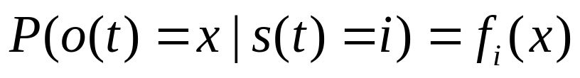
Parameters of HMM
  Two parameter sets in a HMM
    Transition probability a_{ij}
      the probability from one state to another state
    Observation probability f (x)
      the probability of observing a specific residue in a state.
state-dependent

Slide 9
Match States in Profile HMM
Transitional Probabilities
a_{T-1,T}
a₀₁
a₁₂
m₀
m₁
….
m_{T-1}
m_{T}
Observed sequence:
x₁
….
x_{T-1}
x_{T}
f (x₁)
….
f (x_{T-1})
f (x_{T})
Observation Probability Distributions

Slide 10
Insertion and Deletion States in Profile HMM
f (y_{t})
y_{t}
I_{t-1}
I_{t}
M₀
M_{t-1}
M_{t}
M_{t+1}
M_{T}
D_{t}

Slide 11
The Profile HMM as a whole
I₀
I_{t-1}
I_{t}
I _{t+1}
M₀
M_{t-1}
M_{t}
M_{t+1}
M_{T}
D_{t-1}
D_{t}
D_{t+1}

Slide 12
Training the profile HMM
To build an appropriate model for a family, we should use the training data to “train” the model by adapting its parameters to fit in all the training data statistically.
  Usually the Baum-Welch algorithm, which is a kind of EM algorithm, is widely used.

Slide 13
A well trained profile HMM
A | 0.05
K | 0.05
G | 0.05
.. | ...
.. | ...
i0
i1
i2
i3
0.1
A
0.7
K
G
P
F
0.2
d1
d2
d3
A | 0.9
K | 0.05
G | 0.03
P | 0.01
F | 0.01
A | 0.01
K | 0.05
G | 0.03
P | 0.01
F | 0.9

Slide 14
Likelihood of a protein sequence belonging to a family profile model
Find the best path in which the protein sequence match the well trained HMM
Usually, the Viterbi algorithm, which is a kind of dynamic programming, is widely adopted.

Slide 15
Alignment of a sequence with a profile HMM
Given a sequence AGSSPF
S
S
i0
i1
i2
i3
A
K
G
P
F
d1
d2
d3
A
G
P
F

Slide 16
Classifying protein family with profile HMM
a profile HMM of a specific family
I₀
I_{t-1}
I_{t}
I _{t+1}
likelihood
score, S
vlspadktnvkaawgkvgahagemflsfpttktyfp
M₀
M_{t-1}
M_{t}
M_{t+1}
M_{T}
D_{t-1}
D_{t}
D_{t+1}
No
if S<T
Comparotor
(threshold=T)
The sequence does NOT belong to the specific family
if S>T
Yes
The sequence belongs to the specific family

Slide 17
Experiments on the globin family

Slide 18
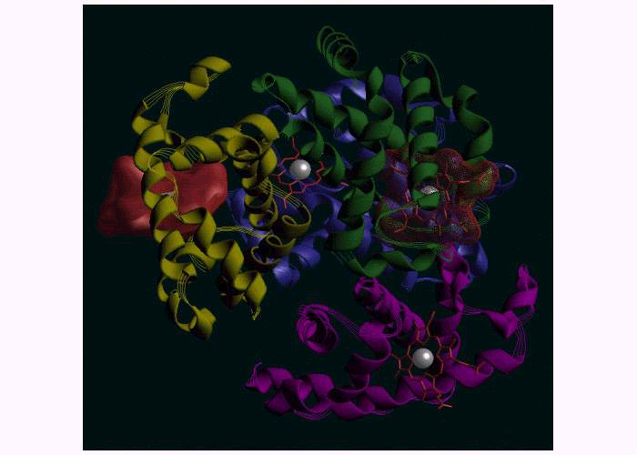
Experiments
We choose the globin family in the initial study, because it is a well defined family, and many members of it are available in the public-domain database.

Slide 19
Data Searching from the Public Domain Database
Swiss-Prot Release 39.22 of 20-Jun-2001 and TrEMBL (http://www.expasy.org/).

Slide 20
Results – Using globin profile HMM
it is classficed as Asctually it is | Globin number (persentage) | Non-Globin number (persentage)
Globin | 700(95.1%) | 36(4.9%) | for Training Set
 | 280 (93.3%) sensitivity | 20(6.7%) | for Testing Set
Non- Globin | 5(0.5%) | 973(99.5%) | for Training Set
 | 7(0.7%) | 976 (99.3%) specificity | for Testing Set

Slide 21
Some drawbacks of the profile HMM

Slide 23
The concept of anti-model
Traditionally, using only the probability
value of the protein family.
Find a heuristic cut point of the probability value, to get best result.
Introduce the concept of anti-model.

Slide 24
The concept of anti-model (cont.)
Besides the profile model of the family, use the random proteins to train an anti-model.
Compare the probability value got from these two model.
To do classification.

Slide 25
The concept of anti-model (cont.)
Use the probability ratio value to do classification.
Theoretical cut point –
proteins in the family get higher probability in profile model.
proteins not in the family get higher probability in random model.
Heuristic cut point –
Shift the cut point from theoretical cut point, to get better result.

Slide 26
Results – Using globin model and anti-model with theoretical cut
classficed as Asctually is | Globin No./rate | Non Glo No./rate | No. of total
Globin | 675(91.7%) 270(90.0%) | 61(8.3%) 30(10.0%) | 736(100%) 300(100%)
Non Globin | 0(0.0%) 0(0.0%) | 978(100%) 983(100%) | 978(100%) 983(100%)

Slide 27
Results – Using globin model and anti-model with heuristic cut
classficed as Asctually is | Globin No./rate | Non Glo No./rate | No. of total
Globin | 708(96.2%) 288(96.0%) | 28(3.8%) 12(4.0%) | 736(100%) 300(100%)
Non Globin | 4(0.4%) 8(0.8%) | 974(99.6%) 975(99.2%) | 978(100%) 983(100%)

Slide 28
Conclusion
Using both the profile model and anti-model with a heuristic cut get better result than using only the profile model
sensitivity specificity
One model 94.2% 99.4%
Theoretical cut 90.8% 100.0%
Heuristic cut 96.1% 99.4%

